Slide 1
Deadlock
Tahira Alam
University of Asia Pacific

Slide 2
What is Deadlock?
A set of blocked processes each holding a resource and waiting to acquire a resource held by another process in the set
Example
System has 2 disk drives
P₁ and P₂ each hold one disk drive and each needs another one

Slide 3
System Model
Processes P₁, P₂, . . ., P_{n}
Resource types R₁, R₂, . . ., R_{m}
CPU cycles, memory space, I/O devices
Each resource type R_{i} has a number of instances
Each process utilizes a resource as follows:
request
use
release

Slide 4
Deadlock Characterization
Deadlock can arise if four conditions hold simultaneously.
Mutual exclusion: only one process at a time can use a resource
Hold and wait: a process holding at least one resource is waiting to acquire additional resources held by other processes

Slide 5
Deadlock Characterization
Deadlock can arise if four conditions hold simultaneously.
No preemption: a resource can be released only voluntarily by the process holding it, after that process has completed its task
Circular wait: there exists a set {P₀, P₁, …, P_{n}} of waiting processes such that P₀ is waiting for a resource that is held by P₁, P₁ is waiting for a resource that is held by P₂, …, P_{n–1} is waiting for a resource that is held by P_{n}, and P_{n} is waiting for a resource that is held by P₀

Slide 6
Resource-Allocation Graph
A set of vertices V and a set of edges E
V is partitioned into two types:
P = {P₁, P₂, …, P_{n}}, the set consisting of all the processes in the system
R = {R₁, R₂, …, R_{m}}, the set consisting of all resource types in the system
request edge – directed edge P_{i} → R_{j}
assignment edge – directed edge R_{j} → P_{i}

Slide 7
Resource-Allocation Graph (Cont.)
Process
Resource Type with 4 instances
P_{i} requests instance of R_{j}
P_{i} is holding an instance of R_{j}
P_{i}
R_{j}
P_{i}
R_{j}

Slide 8
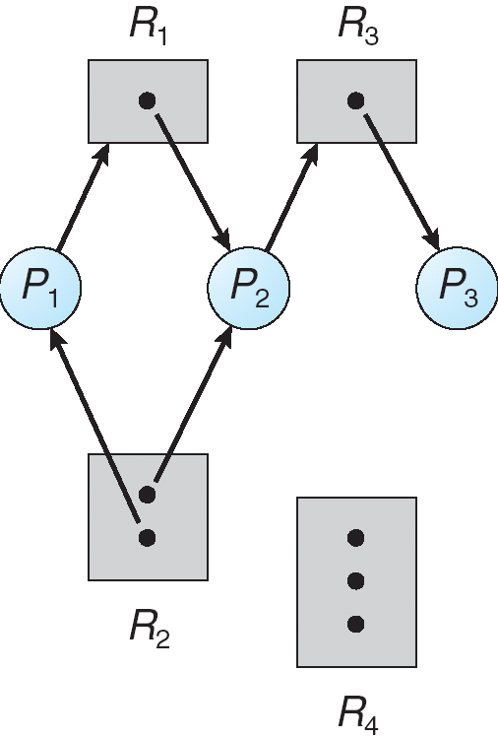
Example of a Resource Allocation Graph

Slide 9
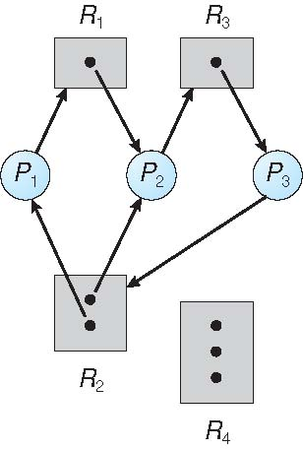
Resource Allocation Graph With A Deadlock

Slide 10
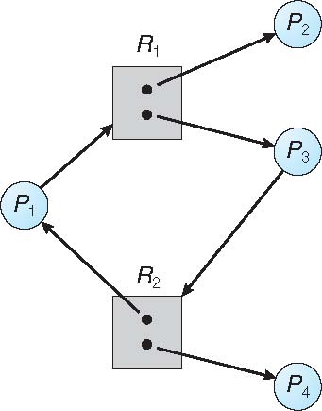
Graph With A Cycle But No Deadlock

Slide 11
Methods of Handling Deadlocks
Prevent or avoid
Detect and recover
Ignore (leave it to application softwares)

Slide 12
Deadlock Prevention
Restrain the ways request can be made
Mutual Exclusion – not required for sharable resources; must hold for nonsharable resources
Hold and Wait – must guarantee that whenever a process requests a resource, it does not hold any other resources
Require process to request and be allocated all its resources before it begins execution, or allow process to request resources only when the process has none
Low resource utilization; starvation possible

Slide 13
Deadlock Prevention (Cont.)
No Preemption –
If a process that is holding some resources requests another resource that cannot be immediately allocated to it, then all resources currently being held are released
Preempted resources are added to the list of resources for which the process is waiting
Process will be restarted only when it can regain its old resources, as well as the new ones that it is requesting
Circular Wait – impose a total ordering of all resource types, and require that each process requests resources in an increasing order of enumeration

Slide 14
Deadlock Avoidance
Requires that the system has some additional a priori information available.
Simplest and most useful model requires that each process declare the maximum number of resources of each type that it may need.
The deadlock-avoidance algorithm dynamically examines the resource-allocation state to ensure that there can never be a circular-wait condition.
Resource-allocation state is defined by the number of available and allocated resources, and the maximum demands of the processes.

Slide 15
Safe State
When a process requests an available resource, system must decide if immediate allocation leaves the system in a safe state.
System is in safe state if there exists a sequence <P₁, P₂, …, P_{n}> of ALL the processes is the systems such that for each P_{i}, the resources that P_{i} can still request can be satisfied by currently available resources + resources held by all the P_{j}, with j < I
That is:
If P_{i} resource needs are not immediately available, then P_{i} can wait until all P_{j} have finished.
When P_{j} is finished, P_{i} can obtain needed resources, execute, return allocated resources, and terminate.
When P_{i} terminates, P_{i +1} can obtain its needed resources, and so on.

Slide 16
Basic Facts
If a system is in safe state ⇒ no deadlocks
If a system is in unsafe state ⇒ possibility of deadlock
Avoidance ⇒ ensure that a system will never enter an unsafe state.

Slide 17
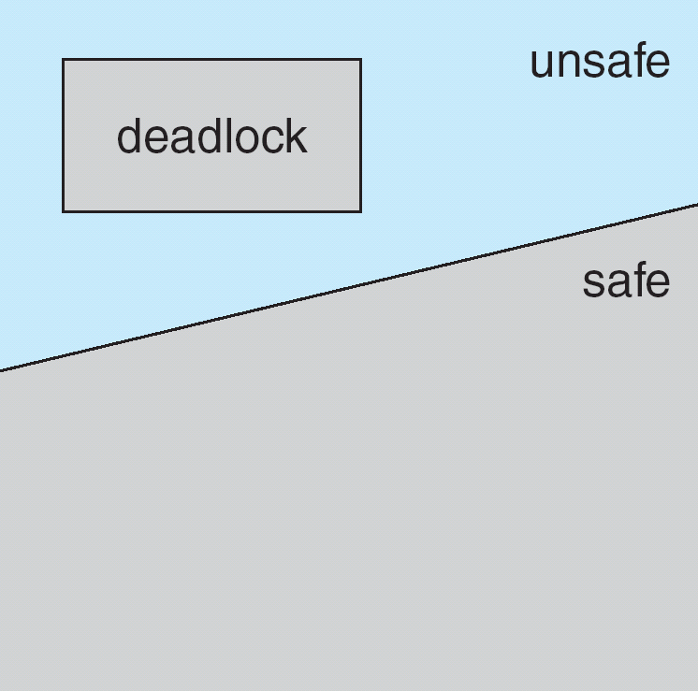
Safe, Unsafe , Deadlock State

Slide 18
Avoidance algorithms
Single instance of a resource type
Use a resource-allocation graph
Multiple instances of a resource type
Use the banker’s algorithm

Slide 19
Resource-Allocation Graph Scheme
Claim edge P_{i} → R_{j} indicated that process P_{j} may request resource R_{j}; represented by a dashed line
Claim edge converts to request edge when a process requests a resource
Request edge converted to an assignment edge when the resource is allocated to the process
When a resource is released by a process, assignment edge reconverts to a claim edge
Resources must be claimed a priori in the system

Slide 20
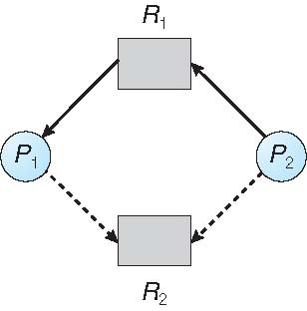
Resource-Allocation Graph

Slide 21
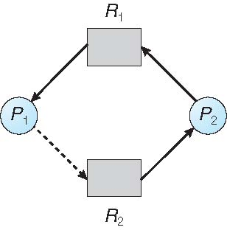
Unsafe State In Resource-Allocation Graph

Slide 22
Resource-Allocation Graph Algorithm
Suppose that process P_{i} requests a resource R_{j}
The request can be granted only if converting the request edge to an assignment edge does not result in the formation of a cycle in the resource allocation graph

Slide 23
Thanks!!!!!

